Slide 1





IWT Economics
Contents:
Cost elements in IWT
Comparisons between the modes
IWT development plans
Financing issues

Slide 2
IWT Cost components
Social cost
Direct (internal) cost/expenditures
Infrastructure cost
  construction
  maintenance
  management
Transport cost
External cost
Emissions
Noise
Safety
Congestion
Use of land
Changes in transport cost can lead to transaction cost and create other economic effects in companies using freight transport (additional indirect economic effects)

Slide 3
IWT Cost components
Cost components in IWT
Driving forces behind transport cost
Fixed cost
Type of vessel
Depreciation
Age
(insured value of the vessel)
Interest
Insurance
Variable cost
Type of vessel
Labour
Type of operation
Maintenance
Route (upstream, downstream, locks)
Fuel

Slide 4
IWT Economics
Direct cost/ expenditures
Transport cost (incl. fees and charges)
Infrastructure cost (maintenance and management, construction)
–
Fees and charges
+
=
TRUE SOCIAL COST
Port fees
Lock usage fees
……
External cost
  Safety
  Emission
  Noise
  Congestion
  Use of Land
  Possibly: indirect economic effects

Slide 5
Comparisons
Container cost example

Slide 6
Break even distance
 | Containers | Dry and liquid bulk
‘wet’ link | 20-40 kms | 20-40 kms
Pre or end-haul Transport | 60-100 kms | 80-120 kms
Pre and end-haul transport | 225-250 kms | 180-200 kms

Slide 7

Interest of OGMO to negotiate special rate for ctnr. Currently, its cost is based in tons.
TECON is structuring a DEPOT on its PRG area and it’s possible to prioritize the inspection of the ctnrs that will be moved to PPA. Saving of R$50,00
Truck cost is a best estimated, considering a facility in a distance of 60km from PPA and 350km from PRG.
Barge cost is based in two situation: uper than 70 Feus=R$800,00 and uper than 100 Feus =R$546,00

Slide 8
IWT Cost

Slide 9
IWT Cost

Slide 10
Social costs

Slide 11
External costs

Slide 12
Energy use

Slide 13
Energy use

Slide 14
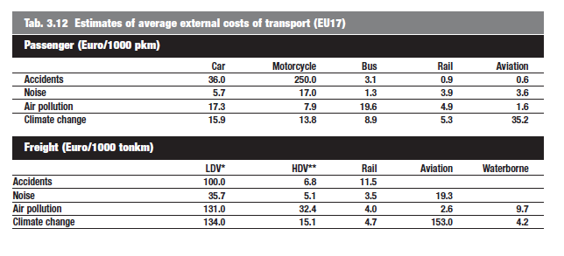
IWT Economics

Slide 15
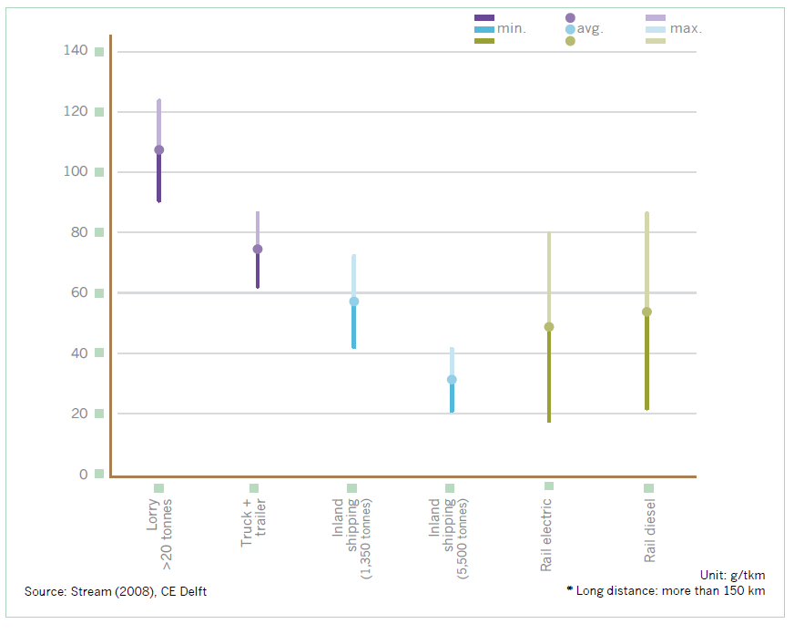
Emission CO2

Slide 16
Emission NOX

Slide 17
Emission PM10

Slide 18
Emission SO2

Slide 19
TRANSPORT- AND SOCIAL COST
SAND AND GRAVEL
Transport cost
Casus 1: Cuijk-Gouda
Social cost
Casus 1: Cuijk Gouda

Slide 20
TRANSPORT- AND SOCIAL COST
SAND AND GRAVEL
Transport cost
Casus 2: Maasbracht-Gouda
With 20 km end-haul transport
Social cost
Casus 2: Maasbracht-Gouda
with 20 km end-haul transport
Rijn-Herneschip (1250 ton) en 20 km over de weg
Weg Kipper (32 ton)

Slide 21
TRANSPORT- AND SOCIAL COST
ORE AND COAL
Transport cost
Rotterdam-Duisburg
Social cost
Rotterdam-Duisburg
* Aangenomen is dat spoor lagere loskosten op de bestemming heeft dan binnenvaart

Slide 22
TRANSPORT- AND SOCIAL COST
ANIMAL FODDER
Transport cost
Casus 1: Rotterdam-Veghel
Social cost
Casus 1: Rotterdam-Veghel

Slide 23
TRANSPORT- AND SOCIAL COST
GRAIN
Transport cost
Reims (Frankrijk) – Den Bosch
Social cost
Reims (Frankrijk) - Den Bosch

Slide 24
TRANSPORT- AND SOCIAL COST
FERTILIZER
Transport cost
Casus 1: Amsterdam-Meppel
Social cost
Casus 1: Amsterdam-Meppel

Slide 25
TRANSPORT- AND SOCIAL COST
RAW MINERALS
Transport cost
Luik - Nijmegen
Social cost
Luik - Nijmegen

Slide 26
TRANSPORT- AND SOCIAL COST
CELLULOSE
Transport cost Vlissingen – Basel
with 20 km end-haul transport
Social cost Vlissingen – Basel
with 20 km end-haul transport
IWT has loaded back haul

Slide 27
TRANSPORT- AND SOCIAL COST
OIL PRODUCTS
Transport cost
Rotterdam-Duisburg (single hull)
Social cost
Rotterdam-Duisburg (single hull)

Slide 28
TRANSPORT- AND SOCIAL COST
BUNKERING DEPOT
Transport cost
Rotterdam-Hengelo
Social cost
Rotterdam-Hengelo

Slide 29
TRANSPORT- AND SOCIAL COST
CHEMICAL PRODUCTS
Transport cost
Rotterdam-Duisburg (double hull)
Social cost
Rotterdam-Duisburg (double hull)

Slide 30
TRANSPORT- AND SOCIAL COST
CONTAINERS TO/FROM SEAPORTS
Transport cost
Rotterdam-Antwerpen
Social cost
Rotterdam-Antwerpen

Slide 31
TRANSPORT- AND SOCIAL COST
CONTAINERS TO/FROM HINTERLAND GERMANY
Transport cost Rotterdam-Duisburg
incl. end-haul transport
Social cost Rotterdam-Duisburg
incl. end-haul transport

Slide 32
TRANSPORT- AND SOCIAL COST
CONTAINERS TO/FROM HINTERLAND DOMESTIC
Transport cost Rotterdam-Tilburg
incl. end-haul transport
Social cost Rotterdam-Tilburg
incl. end-haul transport

Slide 33
TRANSPORT- AND SOCIAL COST
METALS
Transport cost
IJmuiden-Basel incl. end-haul transport
Social cost
IJmuiden-Basel incl. end-haul transport

Slide 34
Effect of new Seine- infrastructure Nord
Cost overview: containers
Travel distance
The construction of Seine Nord will lead to cost decrease of 24% - 59% for container transport

Slide 35
Effect of new Seine- infrastructure Nord
Cost overview: dry bulk
Travel distance
The construction of Seine Nord will lead to a cost decrease of 22% - 25% for the transport of dry bulk cargo

Slide 36
Freight prices spotmarket Rhine dry cargo

Slide 37
Price and cost index
Rhine dry cargo

Slide 38
Price and cost index
Rhine tankers

Slide 39
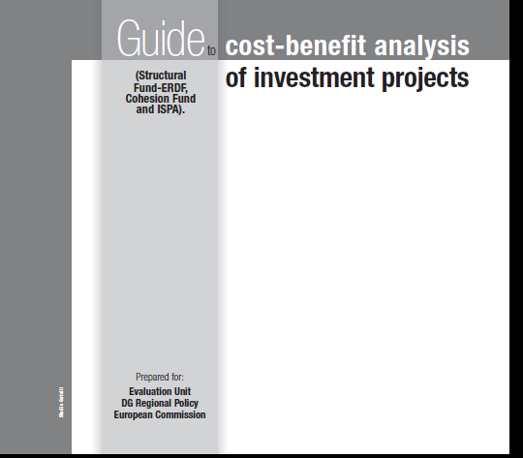
Cost-Benefit Analysis

Slide 40
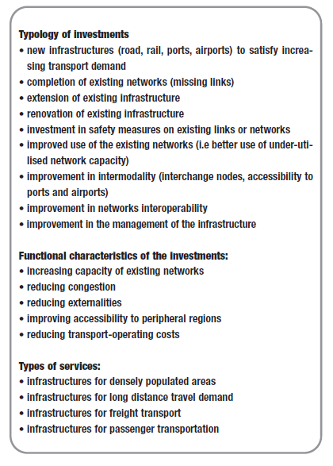
Cost Benefit Analysis

Slide 41
Why invest in IWT?

Slide 42
IWT Economics

Slide 43
IWT Economics

Slide 44
Financing IWT
Role of the banks
in Europe: too easy financing
resulting in: overcapacity
in crisis: bankruptcies
in other countries
no financing because of too high risks
governments can step in (guarantees)

Slide 45
Stimulating IWT
Incentives for:
investments (vessels, terminals)
service support (in start up)
to lower barriers for private sector initiatives

Slide 46
Monitoring is needed
Development of vessel size
Development average carrying capacity
Dry cargo
Tanker

Slide 47
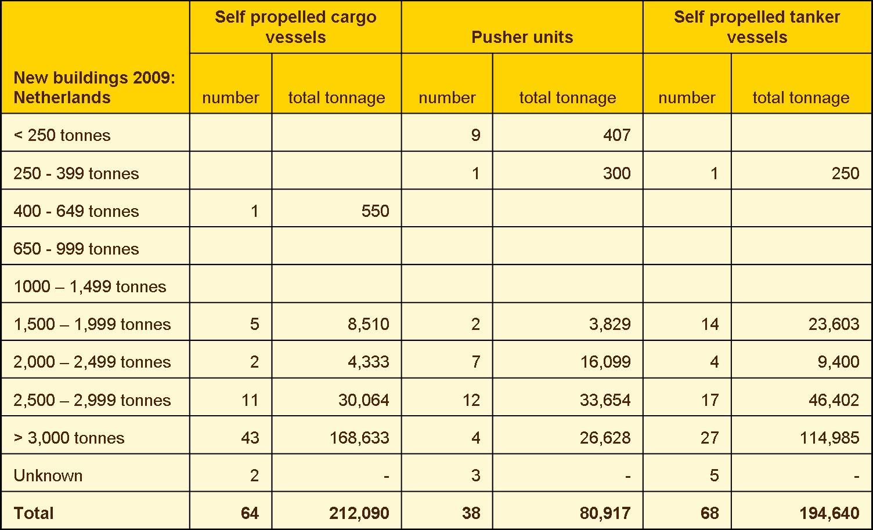
New vessels 2009

Slide 48
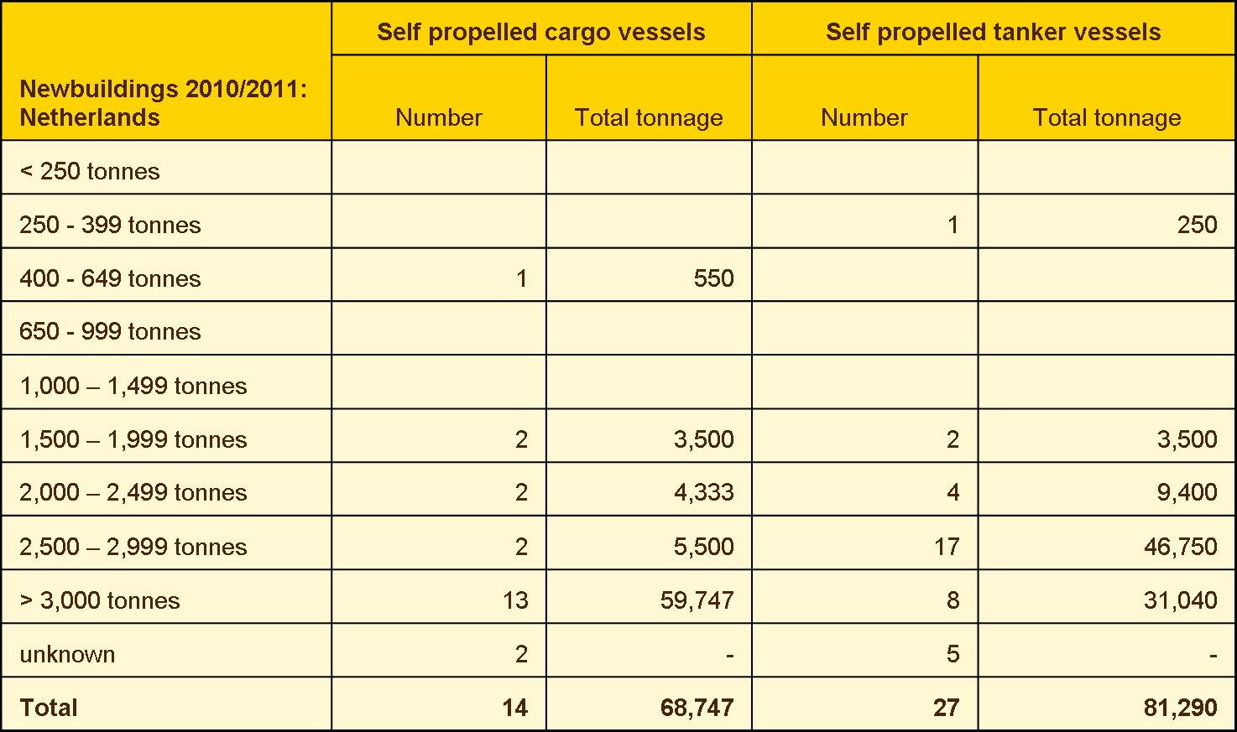
New vessels 2010-2011

Slide 49
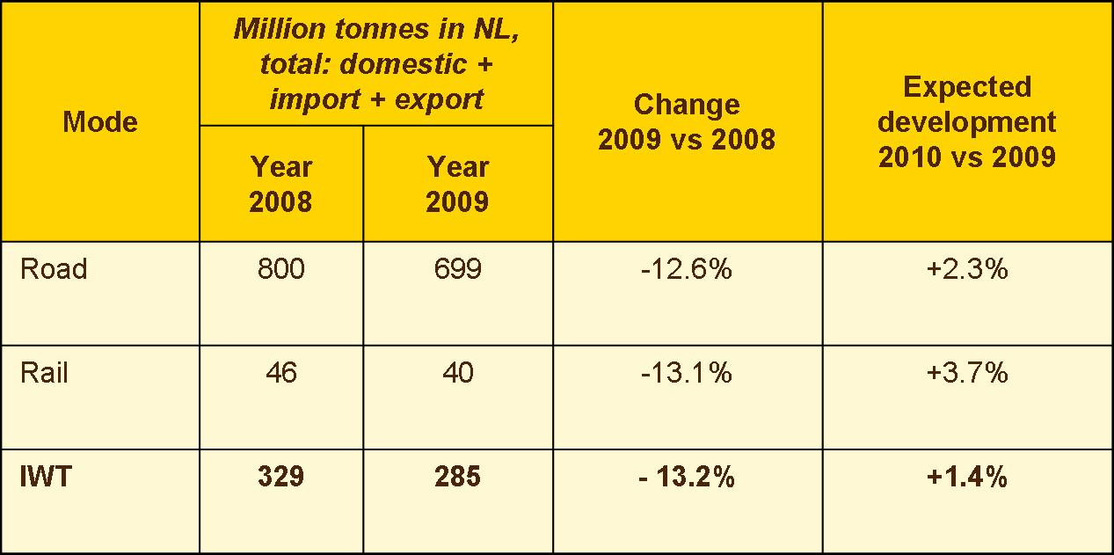
Drop in volume
Due to the crisis

Slide 50
Turn over in IWT
Index: 2005 = 100

